Slide 1
Spaceship Scene
By Alex Dovey, Edward Thornton & Mitch Rycroft

Slide 2
Core Idea
Our main idea is to create immersion by telling a story through a freeze-frame of a scene. This would include both visuals and audio as being a big aspect of achieving this.
The innovative aspect of our project is that we aim to make a surreal environment for the audience. To achieve this we are making time stop but senses continue (such as sound and the player being able to move around the frozen scene).
We do not have a specific target audience for this project as we believe that it can be enjoyed by all ages.

Slide 3
Technology / Materials
To create a large part of this scene, we are using 3Ds Max to 3D model the surrounding environment.
We are also texturing as much as we can in 3Ds Max, and then using the panoramic exporter to create a spherical 360 degree image to apply to the skybox.
As for the code aspect, we plan to use Aframe because it is what we have had most experience with. If we run into issues however, we will look into other options.

Slide 4
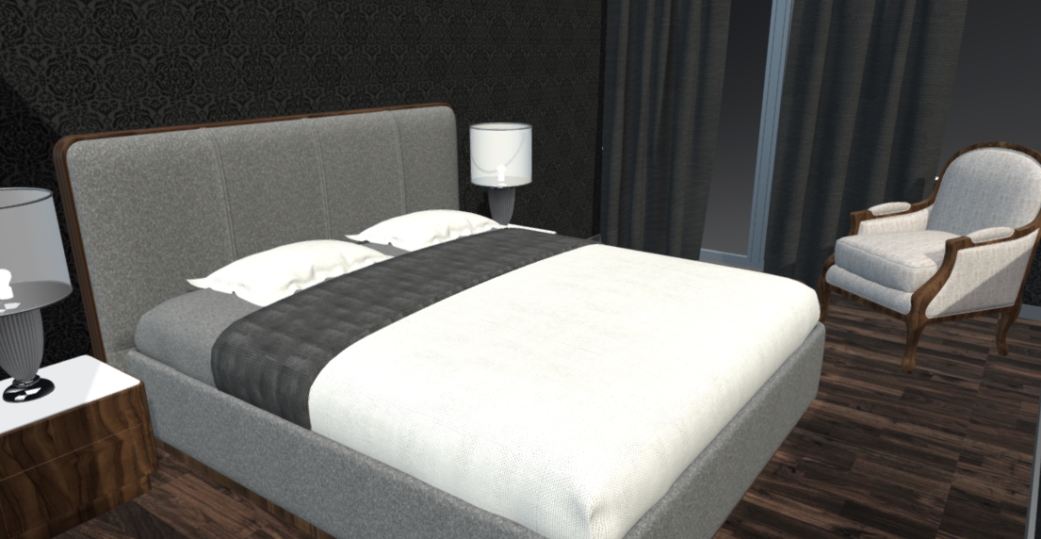
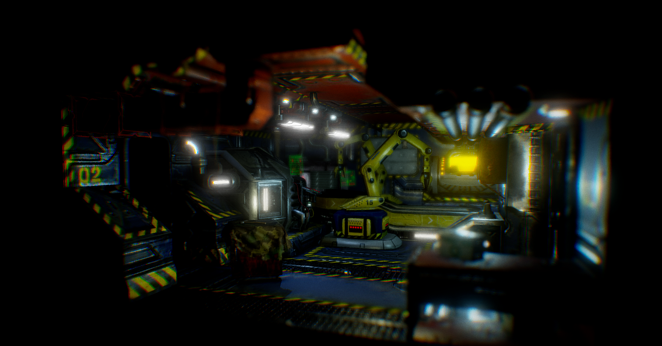
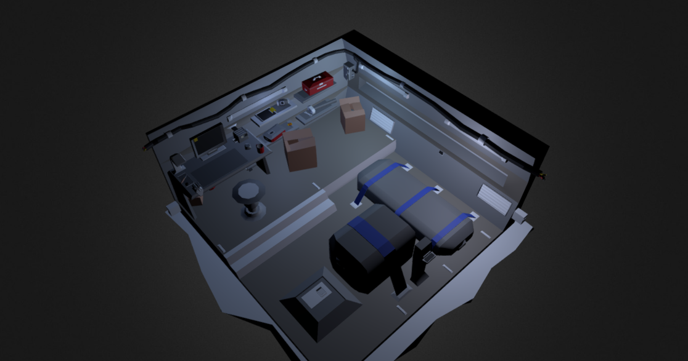
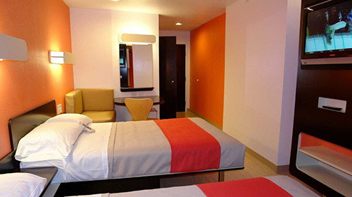
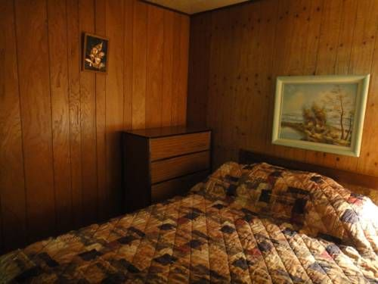
Mood Board

Slide 5
Team Roles
Alex Dovey – Presentation, Core Idea
Edward Thornton – 3D modelling, progression document, coding
Mitch Rycroft – Audio editing, texture creation

Slide 6
Scope of the Prototype
For the finished prototype, we aim to have one room that the player can inspect, with lots of smaller details that the audience see over time.
Whilst this will not be a large environment, we want to pack it with story and interesting visuals.
As a result of the smaller environment, we will be able to do some interesting things with sound effects and surround sound.

Slide 7
Where are we now?
As of now, we have almost completed the creation of the 3D model scene.
The audio is nearly ready to be implemented, along with the textures.
Once these aspects are completed, we will begin the coding of the scene to bring some depth to the experience.
So far, there have not been many challenges, but I am worried that the website will not be able to handle such a large model, and with the amount of textures we will have on top of the model.

Slide 8
Production Plan
Initial idea – 3rd November
Finish model creation – 9th November
Add textures – 10th November
Put onto A-frame – 11th November
Implement sounds – 13th November
Finishing touches – 14th November
Final tester – 15th November

Slide 9
Questions?

